Slide 1



Slide 2

About DoorHub
cyber security startup
revolutionize network defence by a safer attack detection
core target group: military and defence
7 employees
our promise: being the safer sibling to all existing cyber security

Slide 3

the newest innovation

Slide 4
What is Analytical Network User Security?
new machine learning based cyber security approach
military-grade network defence
use of artificial intelligence for total security

Slide 5
Management Philosophy (CRISP-DM)
1. Business understanding
3. Data preparation
4. Modelling
5. Evaluation
6. Deployment
2. Data understanding
Business understanding
detect network anomalies to increase security
Data understanding
analysis of the data set
outline important features
Data preparation
clean and preprocess the data for analysis
Modelling
training of the model
Evaluation
prove the model on test data
analyse false positives and false negatives
Deployment
to be assigned after investment
Github

Slide 6

Three Staged Security Approach
Pre-Login Check
AI Captcha
Continuous Network Traffic Monitoring

Slide 7
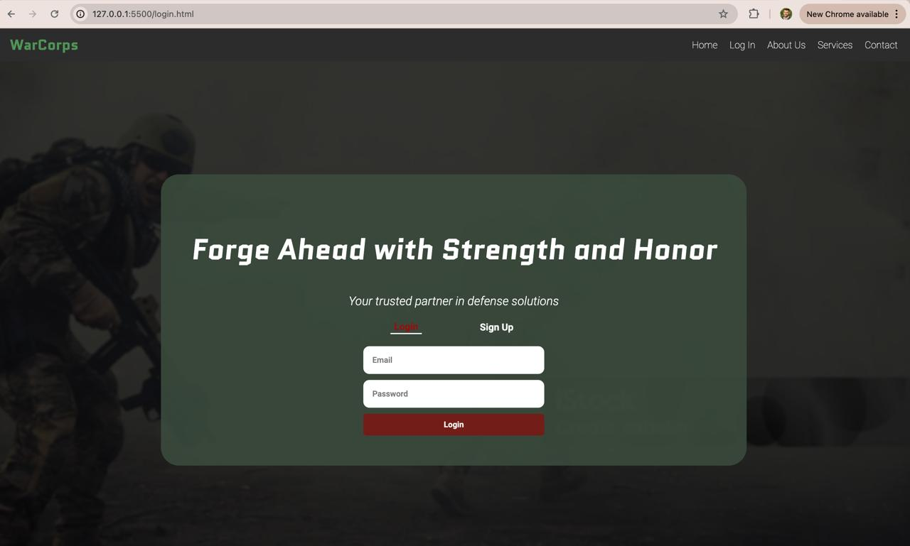
Pre-Login Check
checking all login-relevant features
duration
src_bytes
dst_bytes
num_failed_logins
Count
etc.
machine learning model checks against database

Slide 8

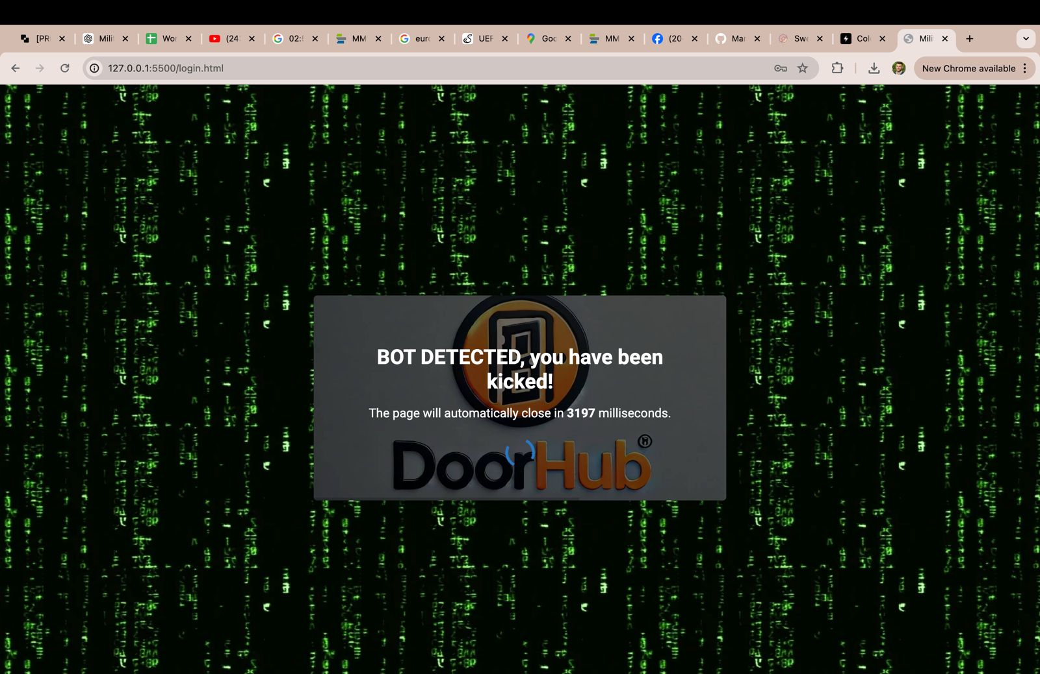

Pre-Login Check
model verifies and checks if the access is either
Denied
Granted

Slide 9
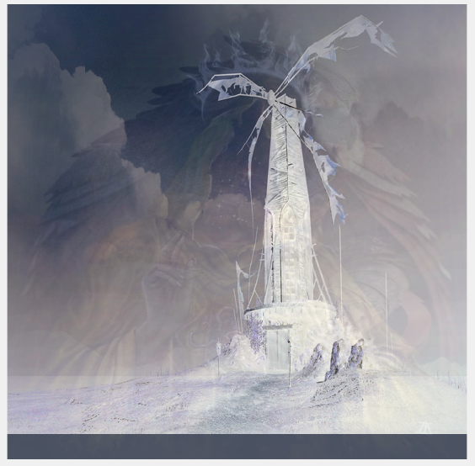
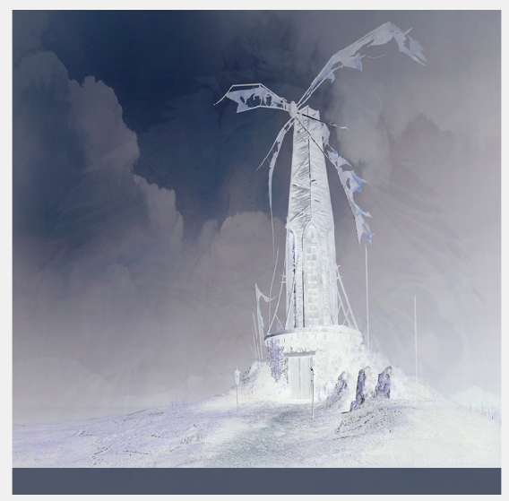
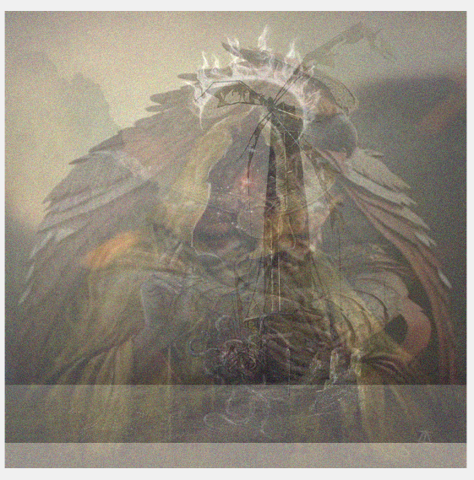
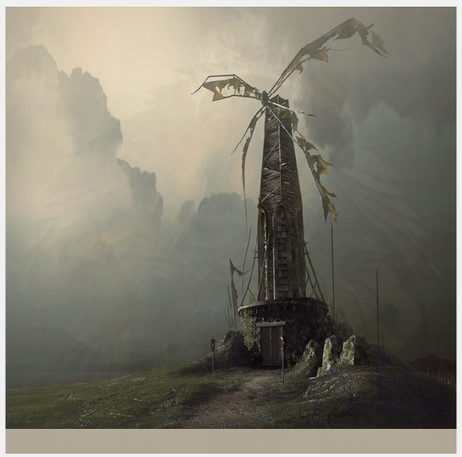

AI Captcha
based on mixing and demixing images
Done by an Individual Component Analysis (ICA)
pictures and outputs are generated randomly
→ hard to recognize and interpret for LLM‘s
mixed pictures ICA
sliced, mixed pictures ICA
mixed pictures with noise ICA
sliced, mixed pictures with noise ICA

Slide 10
Continuous Network Traffic Monitoring
network traffic is checked by machine learning model in real time as the user interacts with the network
suspicious activity → user is blocked immediately + warning message to the administrator

Slide 11
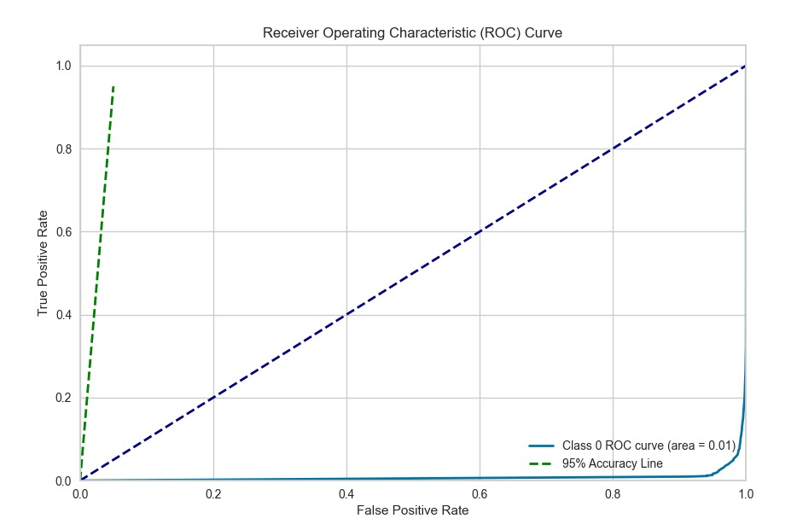
Evaluation
high quality training data
model trained on:
more than 125.000 data points
more than 40 features for training
Best model for this problem: Random Forest Classifier
→ test-accuracy 96,34%

Slide 12
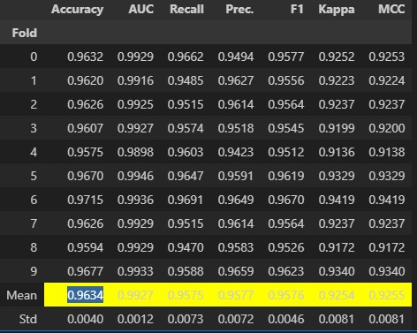
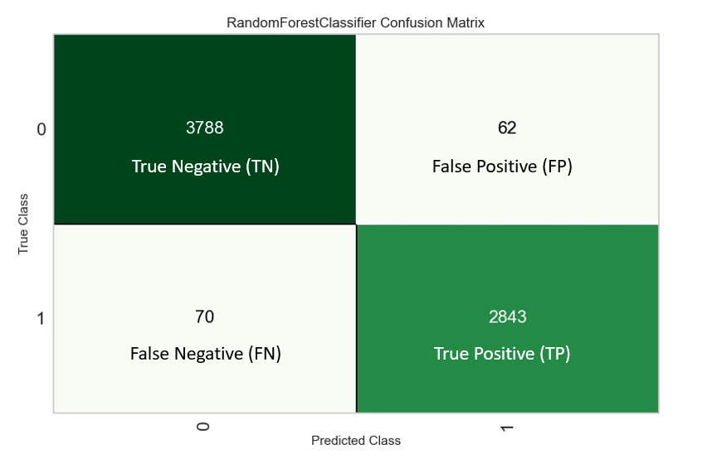
Accuracy and Confusion Matrix
Random Forest Classifier
Mean accuracy
Confusion Matrix

Slide 13

Live Demonstration

Slide 14

Future of DoorHub
offer military-grade safety
lead in cybersecurity innovation and expand business to new markets
continuous model improvement and strategic investment deployment

